Slide 1
CS 211 Computer Architecture Lecture 26: Microarchitecture Design - Datapath – Part 2
Ravi Mittal
ravi.mittal@iitgoa.ac.in
Indian Institute of Technology, Goa

Slide 2
Acknowledgements
Book: Harris and Harris, Digital Design and Computer Architecture – RISC-V
Class Presentation, CS61C, Introduction to Assembly Language and RISC-V Instruction Set Architecture, University of Berkeley, Prof Krste Asanović & Randy H. Katz. http://inst.eecs.Berkeley.edu/~cs61c
Lecture slides of Prof Onur Mutlu, ETH Zurich, Spring 2018,
Book: Pratt and Patel, Introduction to Computing Systems: From Bits & Gates to C/C++ & Beyond

Slide 3
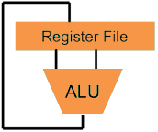
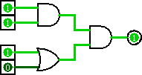
Computer Architecture
Higher-Level Language Program (e.g. C)
temp = v[k];
v[k] = v[k+1];
v[k+1] = temp;
Compiler
lw t0, 0(x2)
lw t1, 4(x2)
sw t1, 0(x2)
sw t0, 4(x2)
Assembly Language Program (e.g. RISCV)
Assembler
0000 1001 1100 0110 1010 1111 0101 1000
1010 1111 0101 1000 0000 1001 1100 0110
1100 0110 1010 1111 0101 1000 0000 1001
0101 1000 0000 1001 1100 0110 1010 1111
Machine Language Program (RISCV)
We are here
Machine Interpretation
Hardware Architecture Description (e.g. block diagrams)
Architecture Implementation
Logic Circuit Description (Circuit Schematic Diagrams)
Notes:
Great Ideas:
Levels of Representation & Interpretation
Technology Trends
Principle of Locality & the Memory Hierarchy
Parallelism
Performance Measurement & Improvement
Dependability via Redundancy

Slide 4
In the class we will study
Flip-Flop Timing behavior
Program Counter – Max Frequency
Register File
Storage Elements for RISC-V machine
Single Cycle, Multicycle, Pipeline Machines

Slide 5
Datapath Components
Microarchitecture has two interacting components
The datapath
The control unit
Datapath operate on words of data
Datapath contains structures such as
Registers
Memories
ALU
Multiplexer
Buses
Control unit
Receives instruction from datapath
It tells datapath how to execute the instructions
It produces control signals for muxes, ALU, registers, Memories

Slide 6
Flip-Flop Timing Behavior

Slide 7
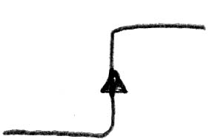
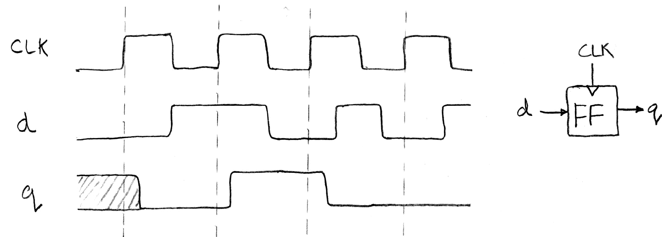
Flip-Flop Timing Terminology (1/2)
Edge-triggered D-type flip-flop
This one is “rising edge-triggered”
On the rising edge of the clock, input d is sampled and transferred to the output. At other times, the input d is ignored and the previously sampled value is retained
Example waveforms:

Slide 8
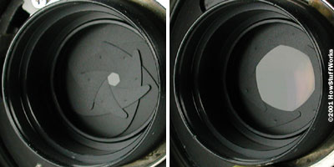
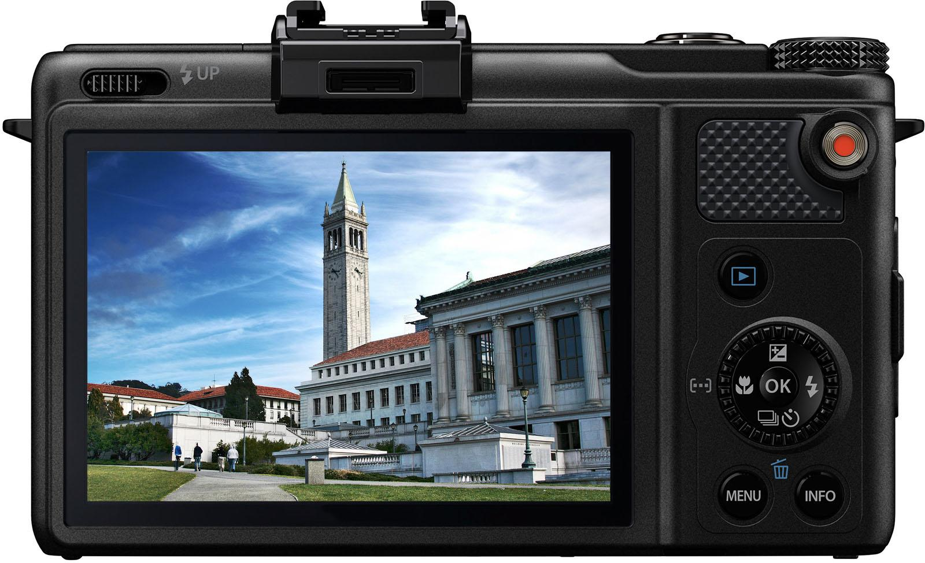
Flip-Flop Timing Terminology (2/3)
Camera Analogy: Taking a photo
Setup time: don’t move since about to take picture (open camera shutter)
Hold time: need to hold still after shutter opens until camera shutter closes
Time to data: time from open shutter until image appears on the output (viewfinder)

Slide 9
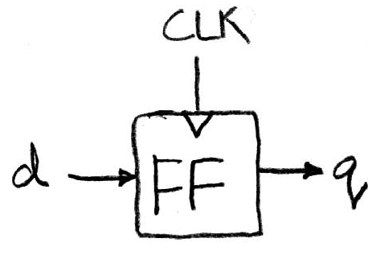
Flip-Flop Timing Terminology (3/3)
Now applied to hardware:
Setup Time: how long the input must be stable before the clock trigger for proper input read
Hold Time: how long the input must be stable after the clock trigger for proper input read
“Clock-to-Q” Delay: how long it takes the output to change, measured from the clock trigger

Slide 10
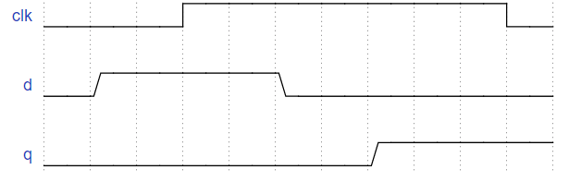
Flip-Flop Timing Behavior

Slide 11
Flip-Flop Timing Behavior
Setup Time

Slide 12
Flip-Flop Timing Behavior
Hold Time

Slide 13
Flip-Flop Timing Behavior
Clock-to-Q

Slide 14
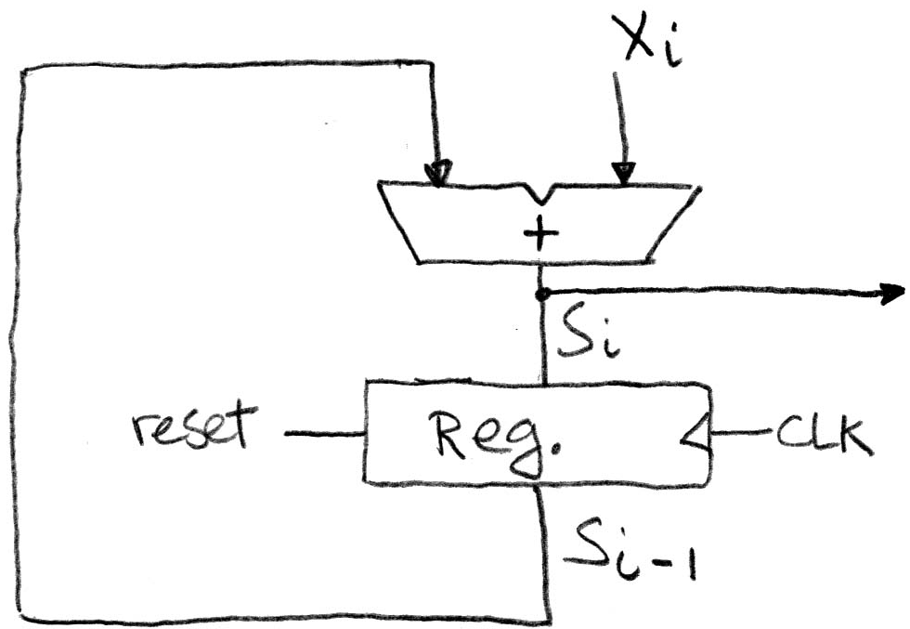
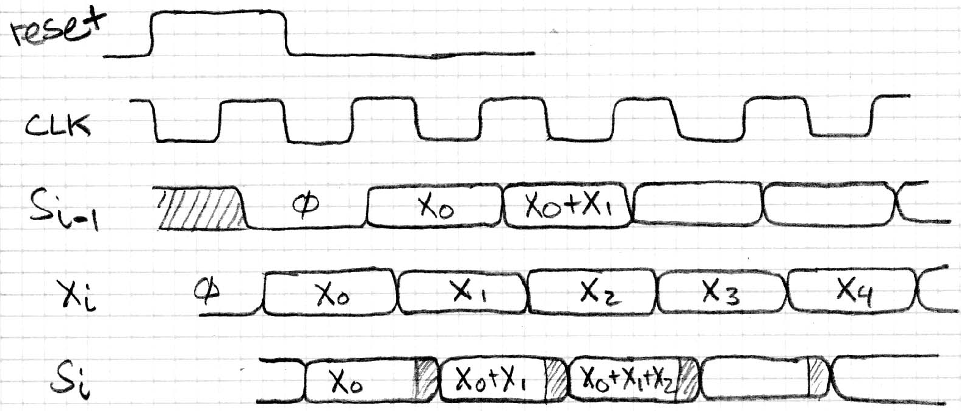
Accumulator Revisited Proper Timing
reset signal shown
In practice X_{i} might not arrive to the adder at the same time as S_{i-1}
S_{i} temporarily is wrong, but register always captures correct value
In good circuits, instability never happens around rising edge of CLK
“Undefined” (unknown) signal

Slide 15
Review of Timing Terms
Clock: steady square wave that synchronizes system
Flip-flop: one bit of state that samples every rising edge of Clock (positive edge-triggered)
Register: several bits of state that samples on rising edge of Clock (positive edge-triggered); also has RESET
Setup Time: when input must be stable before Clock trigger
Hold Time: when input must be stable after Clock trigger
Clock-to-Q Delay: how long it takes output to change from Clock trigger
Notes:
STOP HERE

Slide 16
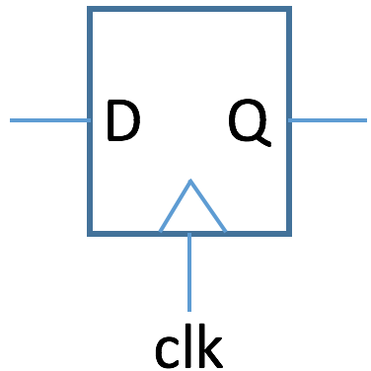
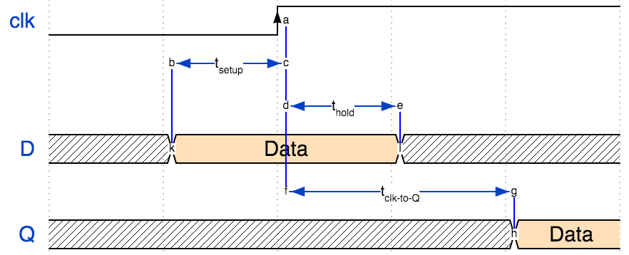
Flip-Flop Timing
Notes:
{signal: [ {name: 'clk', wave: '0.H..', node: '..a'}, { node: '.bc'}, { node: '..de'}, {name: 'D', wave: 'x4.x.', node: '.k.l', data: 'Data'}, { node: '..f.g'}, {name: 'Q', wave: 'x...4', node: '....h', data:'Data'},], edge: [ 'b<->c t<sub>setup', 'k-b', 'a-f', 'd<->e t<sub>hold', 'e-l', 'f<->g t<sub>clk-to-Q', 'g-h' ], config: { hscale: 1.5 }}

Slide 17
Flip-Flop Timing
Time | Description
t_{setup} | time during which D must not change before positive clock edge
t_{hold} | time during which D must not change after positive clock edge
t_{clk-to-Q} | delay after positive clock edge after which D appears at Q output

Slide 18
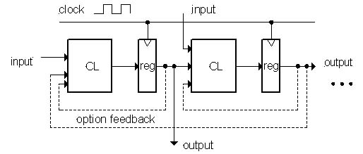
Model for Synchronous Systems
Combinational logic blocks separated by registers
Clock signal connects only to sequential logic elements
Feedback is optional depending on application
How do we ensure proper behavior?
How fast can we run our clock?

Slide 19
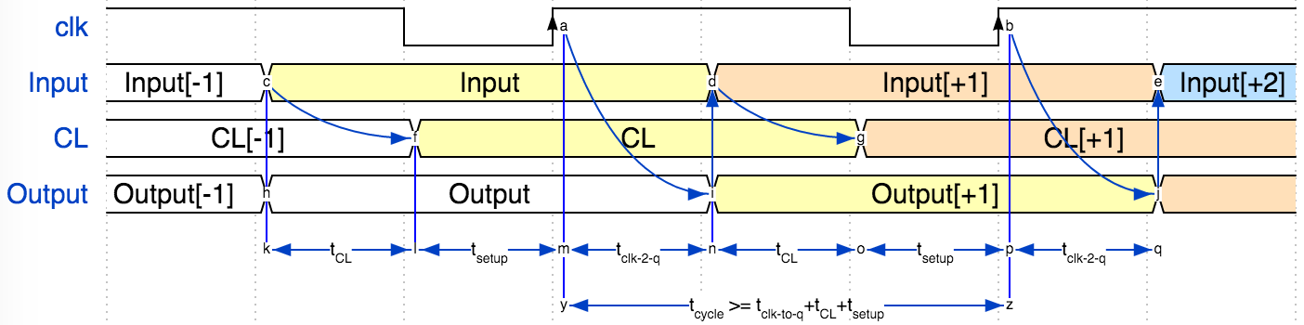
Maximum Clock Frequency
t_{CL}
Clock
Input
Combinatorial
Logic
(CL)
Register
(flip-flops)
CL
Output
Optional Feedback

Slide 20
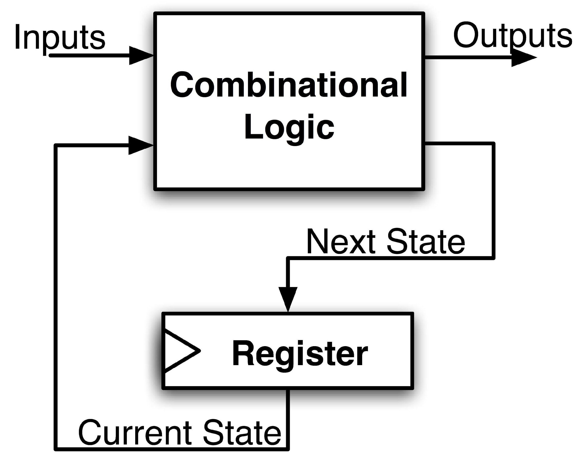
Maximum Clock Frequency
What is the maximum frequency of the circuit?
Limited by how much time is needed to get correct next state to the register
Max Delay =
Min Period = Max Delay
Max Freq = 1/Min Period
CLK-to-Q Delay
+ CL Delay
+ Setup Time
Notes:
Hold time is included in CLK-to-Q delay.
Make sure to shift thinking for setup time for next clock trigger (one clock cycle).

Slide 21
Program Counter – Max Frequency

Slide 22
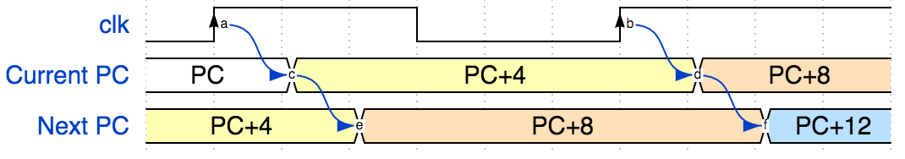
Program Counter (PC)
Current PC
Next PC

Slide 23
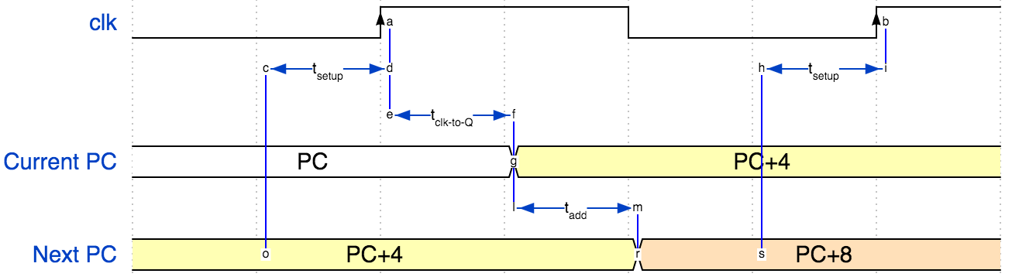
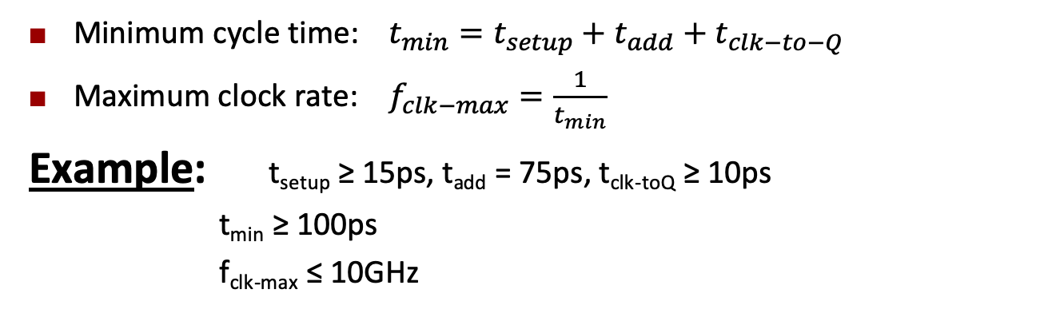
Maximum PC Clock Speed
Minimum cycle time: $t_{min}=t_{setup}+t_{add}+t_{clk−to−Q}$
Maximum clock rate: $f_{clk−max}=\frac{1}{t_{min}}$
Example: t_{setup} ≥ 15ps, t_{add} = 75ps, t_{clk-toQ} ≥ 10ps
t_{min} ≥ 100ps
f_{clk-max} ≤ 10GHz

Slide 24
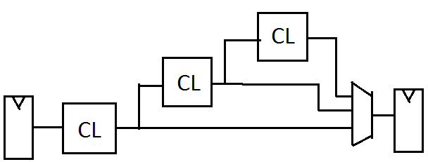
The Critical Path
The critical path is the longest delay between any two registers in a circuit
The clock period must be longer than this critical path, or the signal will not propagate properly to that next register
Critical Path =
CLK-to-Q Delay
+ CL Delay 1
+ CL Delay 2
+ CL Delay 3
+ Adder Delay
+ Setup Time
+
Reg
Reg

Slide 25
The Critical Path
When setting clock period in synchronous systems, must allow for worst case
Path through combinational logic that is worst case called “critical path”
Can be estimated by number of “gate delays”: Number of gates must go through in worst case
Idea: Doesn’t matter if speedup other paths if don’t improve the critical path

Slide 26
How do we go faster?
Pipelining!
Split operation into smaller parts and add a register between each one
We will study pipelining later in the course

Slide 27
Register File

Slide 28
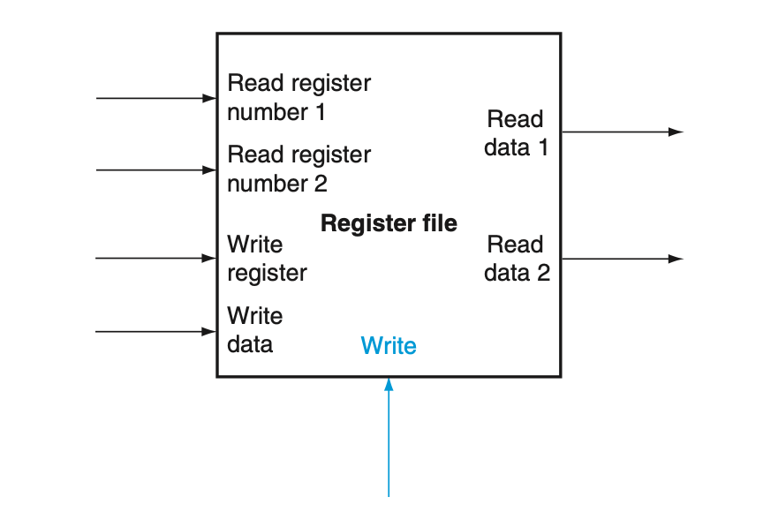

Register File
Write Enable
A register file with two read ports and one write port
Ref: Harris and Harris Book: Digital Design and Computer Architecture: RISC-V Edition

Slide 29
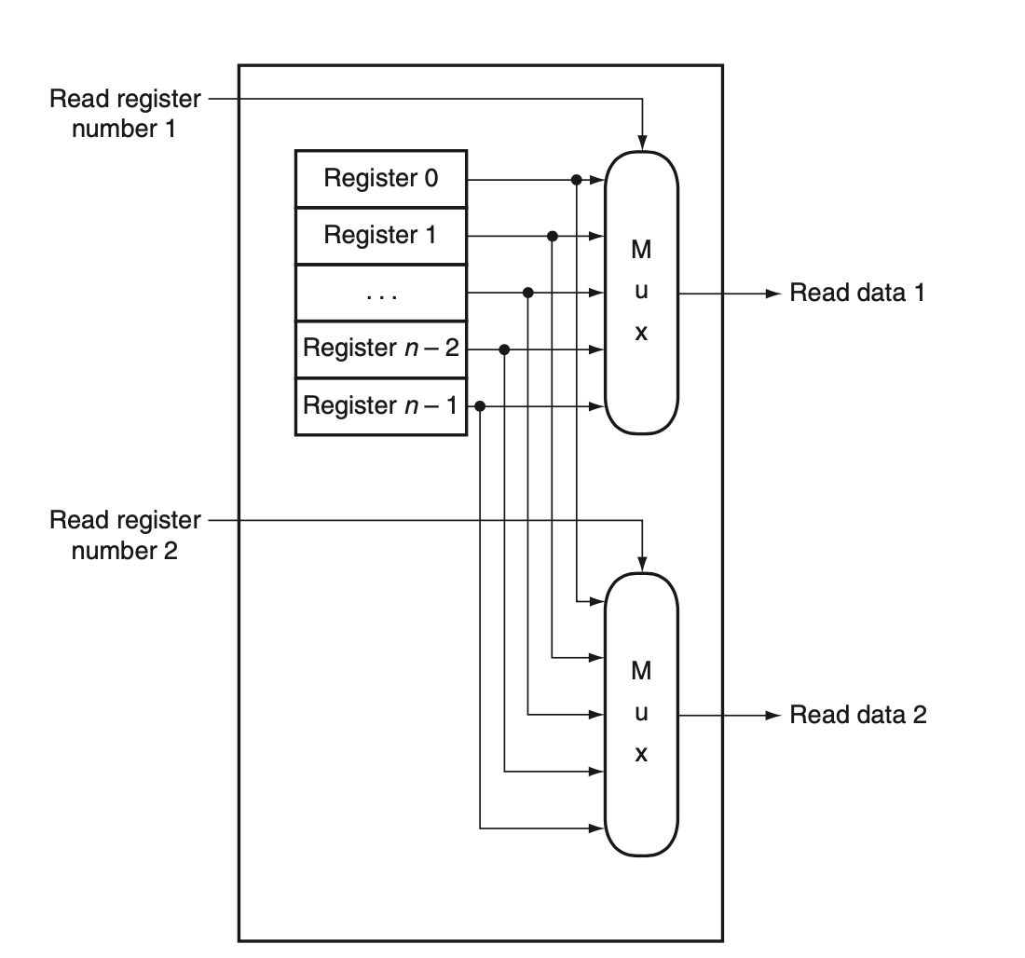
Register File
The implementation of two read ports for a register file with n registers can be done with a pair of n-to-1 multiplexors
Ref: Harris and Harris Book: Digital Design and Computer Architecture: RISC-V Edition

Slide 30
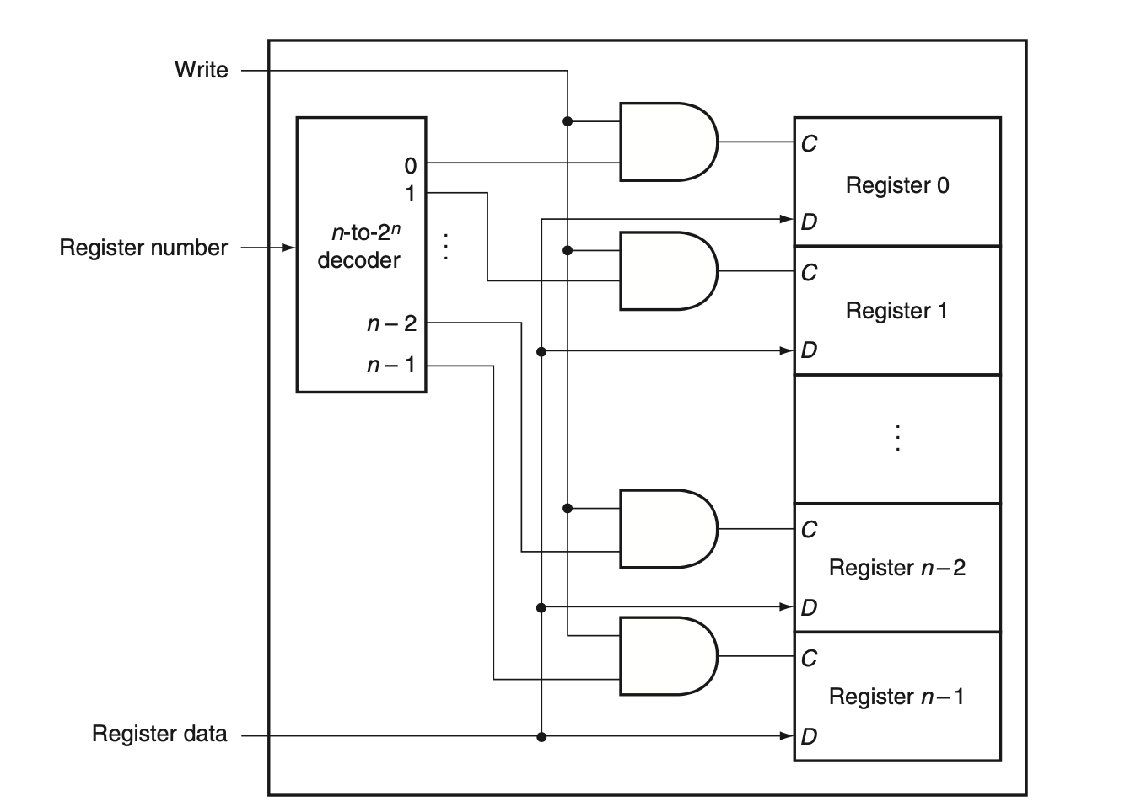
Register File
The write port for a register file is implemented with a decoder that is used with the write signal to generate the C input to the registers
Ref: Harris and Harris Book: Digital Design and Computer Architecture: RISC-V Edition

Slide 31
Finite State Machine (FSM) (Self Reading) - See backup slides

Slide 32
FSM
How do we represent sequential logic?
Truth tables could account for history
We could do boolean logic with prior state as a variable
We can also use a new representation: Finite State Machines

Slide 33
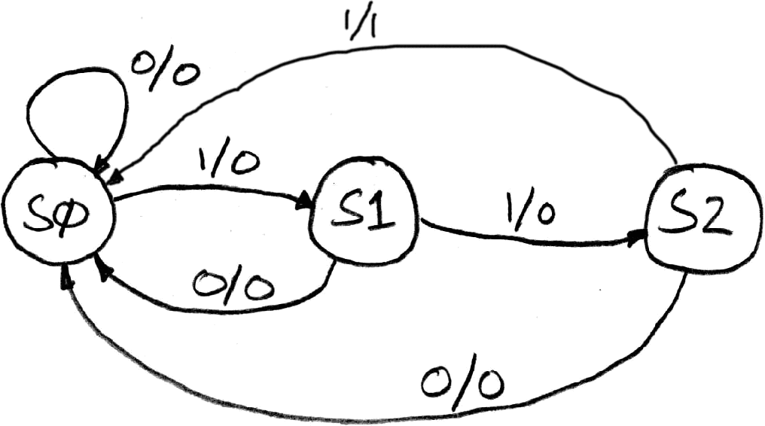
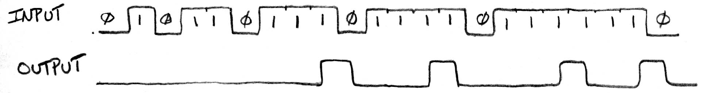
Finite State Machines (FSMs)
A convenient way to conceptualize computation over time
Function can be represented with a state transition diagram
With combinational logic and registers, any FSM can be implemented in hardware!
States: S0, S1, S2
Initial State: S0
Transitions of form:
input/output

Slide 34
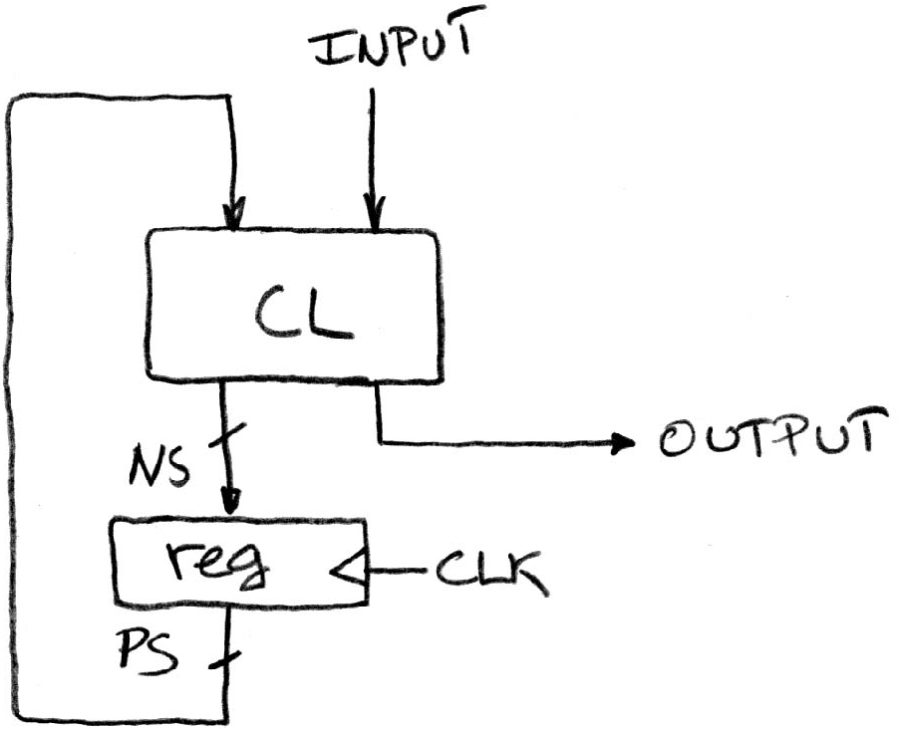
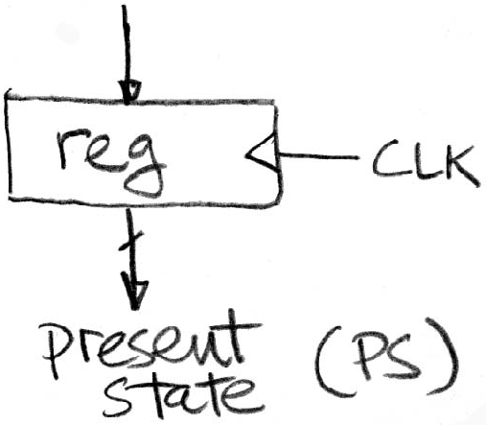
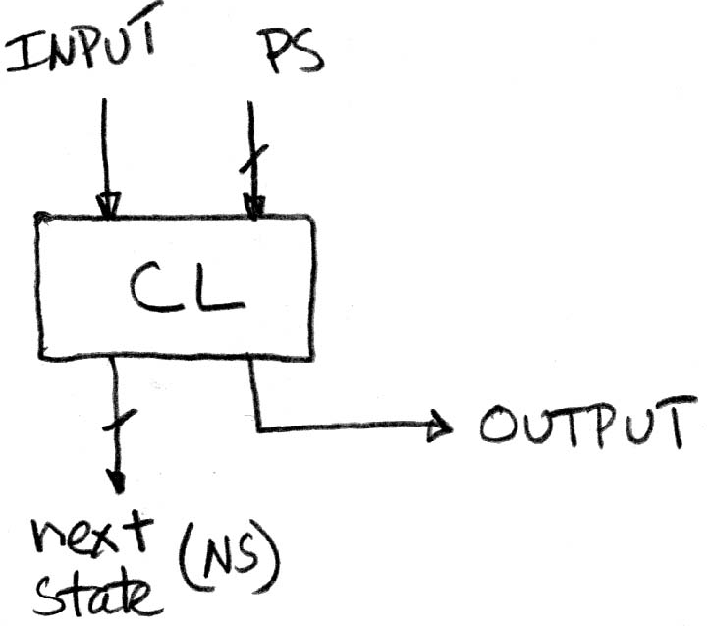
Hardware Implementation of FSM
Register holds a representation of the FSM’s state
Must assign a unique bit pattern for each state
Output is present/current state (PS/CS)
Input is next state (NS)
Combinational Logic implements transition function (state transitions + output)
+
=

Slide 35
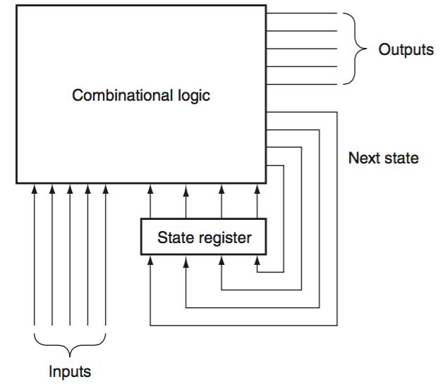
Hardware Implementation of FSM
clock
Notes:
A finite-state machine can be implemented with a register to hold the current state and a block of combinational logic that computes the next-state function and the output function
Figure shows how a finite-state machine with 4 bits of state, and thus up to 16 states, might look.
The combinational logic block is often implemented using structured logic, such as a PLA. A PLA can be constructed automatically from the next-state and output function tables.

Slide 36
Storage Elements

Slide 37
Storage Element: Idealized Memory
Memory (idealized)
One input bus: Data In
One output bus: Data Out
Memory word is found by:
Address selects the word to put on Data Out
Write Enable = 1: address selects the memory word to be written via the Data In bus
Clock input (CLK)
CLK input is a factor ONLY during write operation
During read operation, behaves as a combinational logic block: Address valid ⇒ Data Out valid after “access time”
Write Enable
Address
Data In
DataOut
32
32
Clk
Prof Krste Asanović & Randy H. Katz, Univ of California, Berkeley
Notes:
The last storage element you will need for the datapath is the idealized memory to store your data and instructions.
This idealized memory block has just one input bus (Data In) and one output bus (Data Out).
When Write Enable is 0, the address selects the memory word to put on the Data Out bus.
When Write Enable is 1, the address selects the memory word to be written via the DataIn bus at the next clock tick.
Once again, the clock input is a factor ONLY during the write operation.
During read operation, it behaves as a combinational logic block.
That is if you put a valid value on the address lines, the output bus DataOut will become valid after the access time of the memory.

Slide 38
Storage Element: Register (Building Block)
Similar to D Flip Flop except
N-bit input and output
Write Enable input
Write Enable:
Negated (or deasserted) (0): Data Out will not change
Asserted (1): Data Out will become Data In on rising edge of clock
Write Enable
Data In
Data Out
N
N
clk
Prof Krste Asanović & Randy H. Katz, Univ of California, Berkeley
Notes:
As far as storage elements are concerned, we will need a N-bit register
The significant difference here is that the register will have a Write Enable input.
That is the content of the register will NOT be updated if Write Enable is not asserted (0).
The content is updated at the clock tick ONLY if the Write Enable signal is asserted (1).

Slide 39
Storage Element: Register File
Register File consists of 32 registers:
Two 32-bit output busses:
busA and busB
One 32-bit input bus: busW
Register is selected by:
RA (number) selects the register to put on busA (data)
RB (number) selects the register to put on busB (data)
RW (number) selects the register to be written via busW (data) when Write Enable is 1
Clock input (clk)
Clk input is a factor ONLY during write operation
During read operation, behaves as a combinational logic block:
RA or RB valid ⇒ busA or busB valid after “access time.”
RW
RA
RB
Write Enable
5
5
5
busA
busW
32 x 32-bit
Registers
32
32
busB
Clk
32
Prof Krste Asanović & Randy H. Katz, Univ of California, Berkeley
Notes:
We will also need a register file that consists of 32 32-bit registers with two output busses (busA and busB) and one input bus.
The register specifiers RA and RB select the registers to put on busA and busB respectively.
When Write Enable is 1, the register specifier Rw selects the register to be written via busW.
In our simplified version of the register file, the write operation will occurs at the clock tick.
Keep in mind that the clock input is a factor ONLY during the write operation.
During read operation, the register file behaves as a combinational logic block.
That is if you put a valid value on Ra, then bus A will become valid after the register file’s access time.
Similarly if you put a valid value on Rb, bus B will become valid after the register file’s access time. In both cases (Ra and Rb), the clock input is not a factor.

Slide 40
State Required by RV32I ISA
Each instruction reads and updates this state during execution:
Registers (x0..x31)
Register file (or regfile) Reg holds 32 registers x 32 bits/register: Reg[0].. Reg[31]
First register read specified by rs1 field in instruction
Second register read specified by rs2 field in instruction
Write register (destination) specified by rd field in instruction
x0 is always 0 (writes to Reg[0]are ignored)
Program Counter (PC)
Holds address of current instruction
Memory (MEM)
Holds both instructions and data, in one 32-bit byte-addressed memory space
We’ll use separate memories for instructions (IMEM) and data (DMEM)
Later we’ll replace these with instruction and data caches
Instructions are read (fetched) from instruction memory (assume IMEM read-only)
Load/store instructions access data memory

Slide 41
Single Cycle Vs Multicycle Machines

Slide 42
Single-cycle Machine
Executes an entire instruction in one cycle
The cycle time is limited by the slowest instruction
It doesn’t require any non-architecture state (note that the state elements are: PC, Instruction Memory, Register File, and Data Memory)
Cycle time limited by longest instruction – load word (lw)
Requires separate instruction and data memories
Single-cycle
Multicycle

Slide 43
Multi-cycle Machine
Higher clock speed
Simpler instructions run faster
Control signals needed in the next cycle can be generated in the current cycle
Reuse of functional unit in multiple cycles within an instruction – eg. Adder
Single memory
Fetching instruction in one cycle
Writing data in another cycle
Less hardware requirement
Not in use now
Single-cycle
Multicycle

Slide 44
Pipelined Machines
Applies pipelining to single cycle machine
Executes several instructions simultaneously
High throughput
Must add logic to handle dependencies between simultaneously executing instructions
Requires nonarchitectural pipeline registers
Pipelined processors must access instructions and data in the same cycle → use of separate instruction and data memories
All commercial high-performance processors use pipelining today
Will study this architecture later in the course

Slide 45
Lecture Summary
In logic circuits, the maximum clock frequency depends on
Setup time, Click-to-Q time, and Combinational Circuit delay
One clock cycle should be big enough to accommodate summation of setup time, Click-to-q time, and combinational circuit delay
Synchronous digital circuits use clock signals
Flip-flop / Registers are required for timing synchronization and control instability due to timing mismatch of input signals
Storage elements for RISC-V machine: Register file, Memory
Single cycle designs are simpler – but hardly in use
We will first study single cycle architecture for RISC-V machine

Slide 46
Backup

Slide 47
FSM
Consists of:
State register
Stores current state
Loads next state at clock edge
Combinational logic
Computes the next state
Computes the outputs

Slide 48
Using Hardware Description Language
Hardware Description Language (HDL)
A programming language for describing hardware, used for generating simulations of a hardware design and also as input to synthesis tools that can generate actual hardware
It serves two purposes
It provides an abstract description of the hardware to simulate and debug the design
Hardware implementation using logic synthesis and hardware compilation tools
Two popular HDLs
Verilog is somewhat more heavily used in industry and is based on C
VHDL, which is based on Ada

Slide 49
Comparator: less than
N-bit signed comparator
Ref: Harris and Harris Book: Digital Design and Computer Architecture: RISC-V Edition

Slide 50
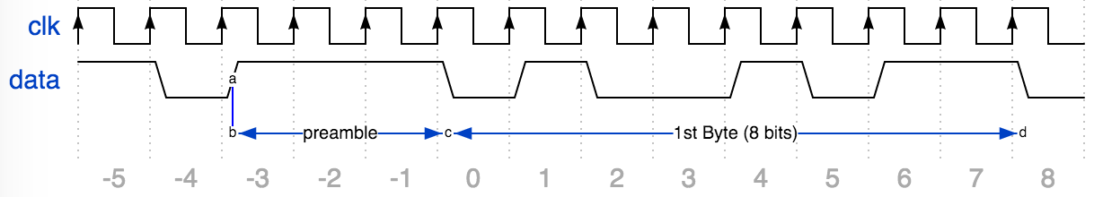
Example: Serial Communication
Wifi sends data “1 bit at a time”
How do we know where a byte “starts”?
Send “preamble …”
E.g. 3 one’s in a row

Slide 51
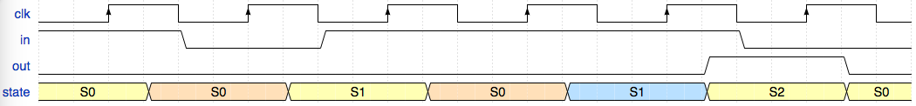
FSM* to Detect 3 One’s
* FSM = Finite State Machine
FSM to detect the occurrence of 3 consecutive 1’s in the input.
State transition diagram:
State transitions are controlled by
the clock: on each clock cycle the FSM
checks the inputs,
transitions to a new state, and
produces a new output …
Notes:
{signal: [ {name: 'clk', wave: 'l.H.l.H.l.H.l.H.l.H.l.H.l'}, {name: 'in', wave: '1...0...1...........0....'}, {name: 'out', wave: '0..................1...0.'}, {name: 'state', wave: '3..4...3...4...5...3...3.', data:['S0', 'S0', 'S1', 'S0', 'S1', 'S2', 'S0']},]}

Slide 52
FSM to Detect 3 One’s
FSM to detect the occurrence of 3 consecutive 1’s in the input.
State transition diagram:
Notes:
{signal: [ {name: 'clk', wave: 'l.H.l.H.l.H.l.H.l.H.l.H.l'}, {name: 'in', wave: '1...0...1...........0....'}, {name: 'out', wave: '0..................1...0.'}, {name: 'state', wave: '3..4...3...4...5...3...3.', data:['S0', 'S0', 'S1', 'S0', 'S1', 'S2', 'S0']},]}

Slide 53

FSM to Detect 3 One’s
FSM to detect the occurrence of 3 consecutive 1’s in the input.
State transition diagram:
State transitions are controlled by
the clock: on each clock cycle the FSM
checks the inputs,
transitions to a new state, and
produces a new output …
Notes:
{signal: [ {name: 'clk', wave: 'l.H.l.H.l.H.l.H.l.H.l.H.l'}, {name: 'in', wave: '1...0...1...........0....'}, {name: 'out', wave: '0..................1...0.'}, {name: 'state', wave: '3..4...3...4...5...3...3.', data:['S0', 'S0', 'S1', 'S0', 'S1', 'S2', 'S0']},]}

Slide 54
FSM Combinatorial Logic
State Encoding
Truth Table
State | Code
Current State | Input | Next State | Output

Slide 55
FSM Combinatorial Logic
State Encoding
Truth Table
State | Code
PS | Input | NS | Output
XX | 0 | 00 | 0
00 | 1 | 01 | 0
01 | 1 | 10 | 0
10 | 1 | 00 | 1
11 | X | 00 | 0
State | Code
S0 | 00
S1 | 01
S2 | 10
unused | 11

Slide 56
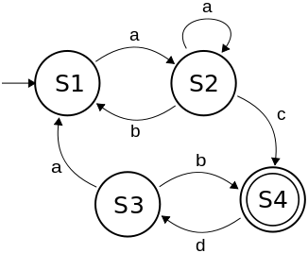
Finite State Machines (FSM) - Summary
Describe computation over time
Represent FSM with “state transition diagram”
Start at given state and input, follow some edge to next (or same) state
With combinational logic and registers, any FSM can be implemented in hardware
state transition diagram

Slide 57
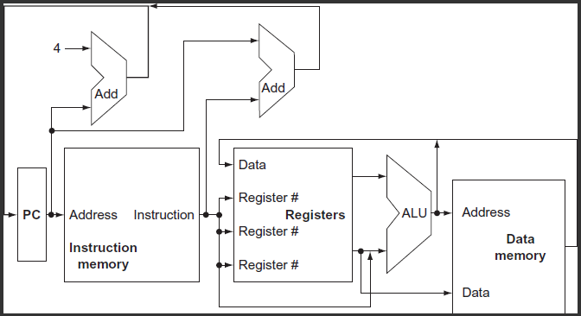
Conceptual RISC-V Datapath
Prof Krste Asanović & Randy H. Katz, Univ of California, Berkeley

